Slide 1
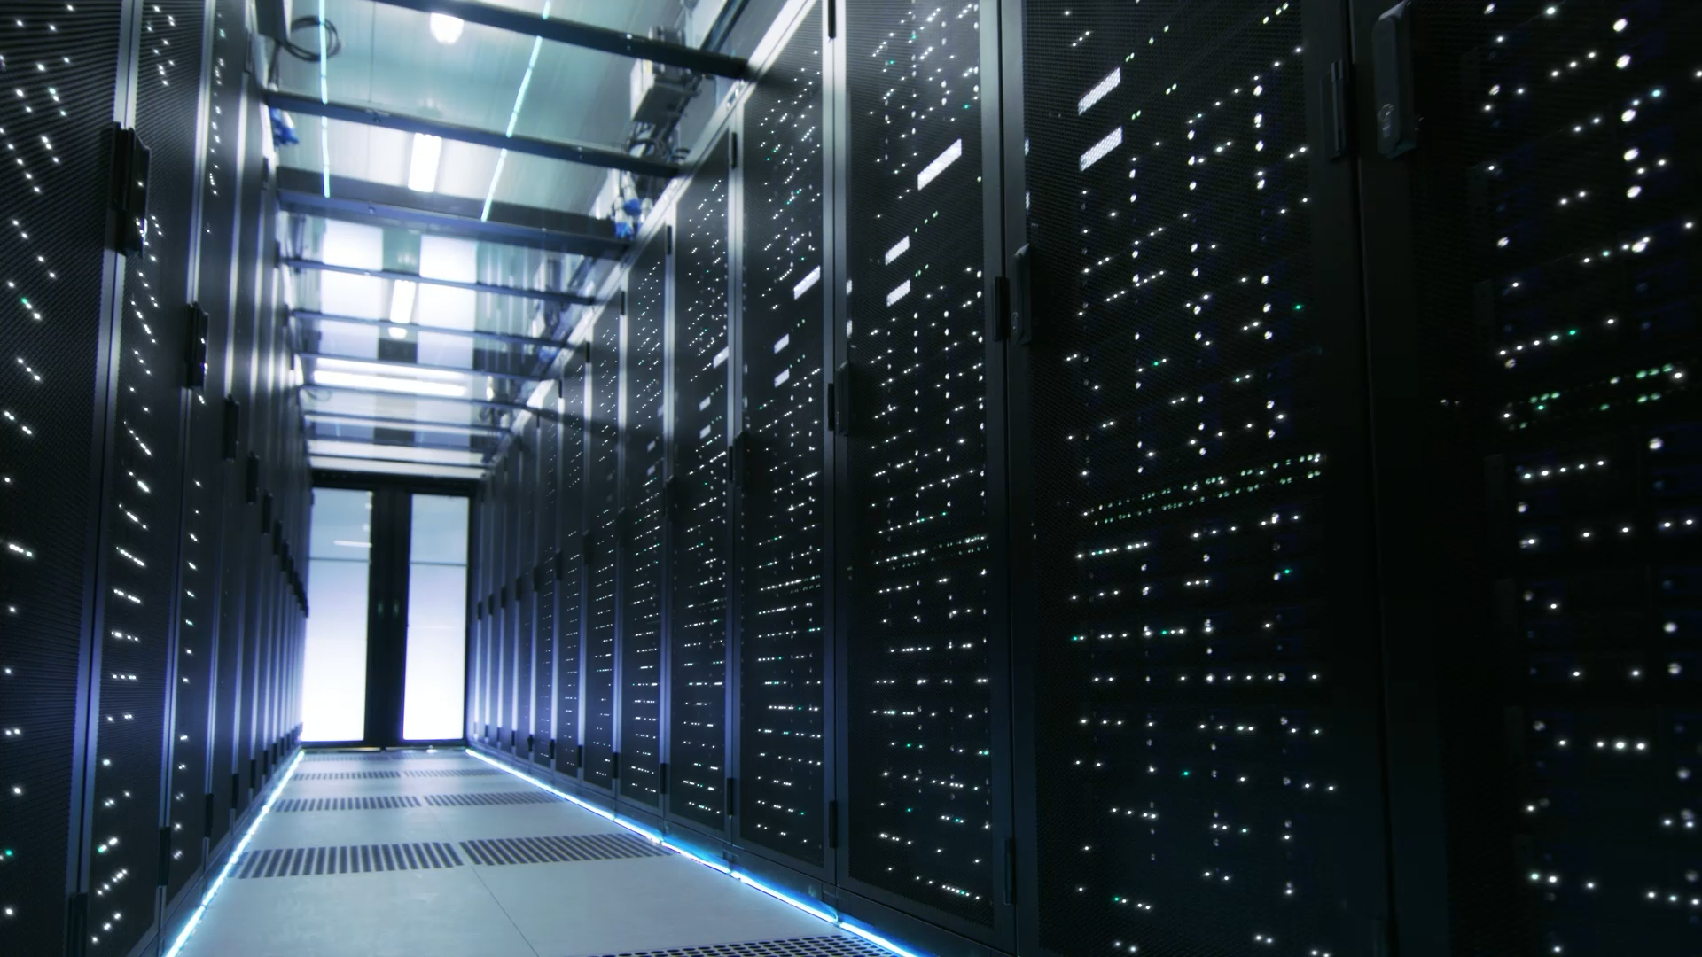
Computer Organization of IOT
By
Mr. Gaurav A. Haral

Slide 2
Table of Contents
Introduction to IOT
History of IOT
How IOT has changed humankind?
Organizational Structure of IOT
Applications of IOT
Boon and Bane of IOT

Slide 3
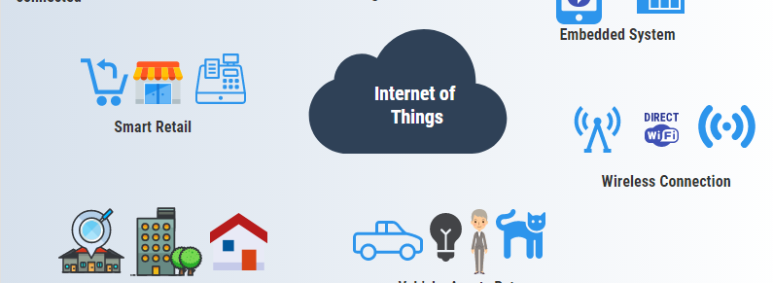
Introduction to IOT
The Internet of Things, or IoT, refers to the billions of physical devices around the world that are now connected to the internet, all collecting and sharing data.
IoT is a network of tiny innovations like the sensors which can be attached to possibly anything available and then make them communicate with the cloud server without any human interaction.

Slide 4
A thing in the internet of things can be a person with a heart monitor implant, a farm animal with a biochip transponder, an automobile that has built-in sensors to alert the driver when tire pressure is low or any other natural or man-made object that can be assigned an Internet Protocol (IP) address and is able to transfer data over a network.
Increasingly, organizations in a variety of industries are using IoT to operate more efficiently, better understand customers to deliver enhanced customer service, improve decision-making and increase the value of the business.

Slide 5
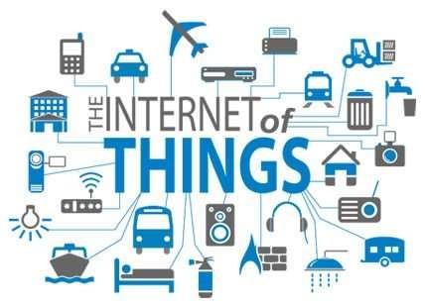
History of IOT
The Internet of Things (IoT) has not been around for very long. However, there have been visions of machines communicating with one another since the early 1800s. Machines have been providing direct communications since the telegraph (the first landline) was developed in the 1830s and 1840s. Described as “wireless telegraphy,” the first radio voice transmission took place on June 3, 1900, providing another necessary component for developing the Internet of Things. The development of computers began in the 1950s.

Slide 6
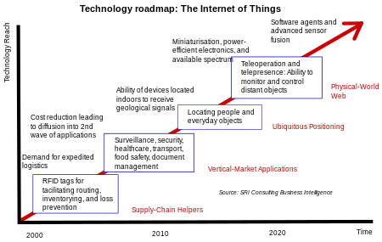
Technology Roadmap for IOT

Slide 7
How IOT has changed humankind
The Internet of Things is vastly changing our world, whether this is at home, in the car, at work or even in the street. Gartner has predicted that by 2020 20.8 billion devices will be connected and some are even saying it could be as many as 50 billion! As our lives are becoming more centred around technology and being seamlessly connected to one another we look at what impact IoT has on our daily lives.
The internet of things helps people live and work smarter, as well as gain complete control over their lives. In addition to offering smart devices to automate homes, IoT is essential to business. IoT provides businesses with a real-time look into how their systems really work, delivering insights into everything from the performance of machines to supply chain and logistics operations.

Slide 8
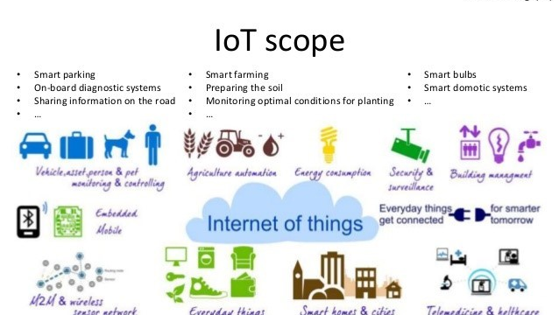
IoT enables companies to automate processes and reduce labor costs. It also cuts down on waste and improves service delivery, making it less expensive to manufacture and deliver goods, as well as offering transparency into customer transactions.
As such, IoT is one of the most important technologies of everyday life, and it will continue to pick up steam as more businesses realize the potential of connected devices to keep them competitive.

Slide 9
Organization Structure of IOT
The IoT can be viewed as a gigantic network consisting of network of devices and computers connected through a series of intermediate technologies where numerous technologies like RFIDs, wireless connections may act as enablers of this connectivity.
Tagging Things : Real-time item traceability and addressability by RFIDs.
Feeling Things : Sensors act as primary devices to collect data from the environment.
Shrinking Things : Miniaturization and Nanotechnology has provoked the ability of smaller things to interact and connect within the “things” or “smart devices.”
Thinking Things : Embedded intelligence in devices through sensors has formed the network connection to the Internet. It can make the “things” realizing the intelligent control.

Slide 10
How does IoT work?
An IoT ecosystem consists of web-enabled smart devices that use embedded systems, such as processors, sensors and communication hardware, to collect, send and act on data they acquire from their environments. IoT devices share the sensor data they collect by connecting to an Iot gateway or other edge device where data is either sent to the cloud to be analyzed or analyzed locally. Sometimes, these devices communicate with other related devices and act on the information they get from one another. The devices do most of the work without human intervention, although people can interact with the devices -- for instance, to set them up, give them instructions or access the data.

Slide 11
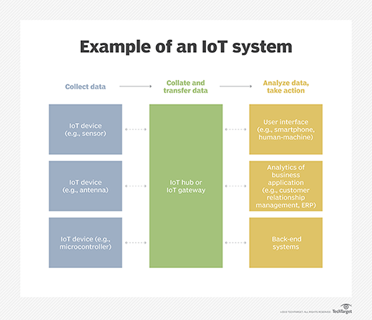

Slide 12
The internet of things helps people live and work smarter, as well as gain complete control over their lives. In addition to offering smart devices to automate homes, IoT is essential to business. IoT provides businesses with a real-time look into how their systems really work, delivering insights into everything from the performance of machines to supply chain and logistics operations.
IoT enables companies to automate processes and reduce labor costs. It also cuts down on waste and improves service delivery, making it less expensive to manufacture and deliver goods, as well as offering transparency into customer transactions.
As such, IoT is one of the most important technologies of everyday life, and it will continue to pick up steam as more businesses realize the potential of connected devices to keep them competitive.

Slide 13
Application of IOT
1. Wearables.
Virtual glasses, fitness bands to monitor for example calorie expenditure and heart beats, or GPS tracking belts, are just some examples of wearable devices that we have been using for some time now. Companies such as Google, Apple, Samsung and others have developed and introduced the Internet of Things and the application thereof into our daily lives.
These are small and energy efficient devices, which are equipped with sensors, with the necessary hardware for measurements and readings, and with software to collect and organize data and information about users.
2. Health.
The use of wearables or sensors connected to patients, allows doctors to monitor a patient's condition outside the hospital and in real-time. Through continuously monitoring certain metrics and automatic alerts on their vital signs, the Internet of Things helps to improve the care for patients and the prevention of lethal events in high-risk patients.
Another use is the integration of IoT technology into hospital beds, giving way to smart beds, equipped with special sensors to observe vital signs, blood pressure, oximeter and body temperature, among others.

Slide 14
3. Traffic monitoring.
The Internet of things can be very useful in the management of vehicular traffic in large cities, contributing to the concept of smart cities.
When we use our mobile phones as sensors, which collect and share data from our vehicles through applications such as Waze or Google Maps, we are using the Internet of Things to inform us and at the same time contribute to traffic monitoring, showing the conditions of the different routes, and feeding and improving the information on the different routes to the same destination, distance, estimated time of arrival.
4. Fleet management.
The installation of sensors in fleet vehicles helps to establish an effective interconnectivity between the vehicles and their managers as well as between the vehicles and their drivers. Both driver and manager/ owner can know all kinds of details about the status, operation and needs of the vehicle, just by accessing the software in charge of collecting, processing and organizing the data. Even, receive alarms in real time of maintenance incidents without having been detected by the driver.
The application of the Internet of Things to fleet management assists with geolocation (and with it the monitoring of routes and identification of the most efficient routes), performance analysis, telemetry control and fuel savings , the reduction of polluting emissions to the environment and can even provide valuable information to improve the driving of vehicles.

Slide 15
5. Agriculture.
Smart farms are a fact. The quality of soil is crucial to produce good crops, and the Internet of Things offers farmers the possibility to access detailed knowledge and valuable information of their soil condition.
Through the implementation of IoT sensors, a significant amount of data can be obtained on the state and stages of the soil. Information such as soil moisture, level of acidity, the presence of certain nutrients, temperature and many other chemical characteristics, helps farmers control irrigation, make water use more efficient, specify the best times to start sowing, and even discover the presence of diseases in plants and soil.
6. Hospitality.
The application of the IoT to the hotel industry brings with it interesting improvements in the quality of the service. With the implementation of electronic keys, which are sent directly to the mobile devices of each guest, it is possible to automate various interactions.
Thus, the location of the guests, the sending of offers or information on activities of interest, the realization of orders to the room or room service , the automatic charge of accounts to the room or the request of personal hygiene supplies, are activities that can be easily managed through integrated applications using the Internet of Things technology.
With the use of electronic keys, the check-out process is automated, disabling the operation of doors, offering information about the rooms immediately available, and even assigning housekeeping tasks to maintenance personnel.

Slide 16
7. Smart grid and energy saving.
The progressive use of intelligent energy meters, or meters equipped with sensors, and the installation of sensors in different strategic points that go from the production plants to the different distribution points, allows better monitoring and control of the electrical network.
By establishing a bidirectional communication between the service provider company and the end user, information of enormous value can be obtained for the detection of faults, decision making and repair thereof.
It also allows offering valuable information to the end user about their consumption patterns and about the best ways to reduce or adjust their energy expenditure.
8. Water supply.
A sensor, either incorporated or adjusted externally to water meters, connected to the Internet and accompanied by the necessary software , helps to collect, process and analyze data, which allows understanding the behavior of consumers, detecting faults in the supply service, report results and offer courses of action to the company that provides the service.
Likewise, it offers final consumers the possibility of tracking their own consumption information, through a web page and in real time, even receiving automatic alerts in case of detecting consumption out of range to their average consumption record, which could indicate the presence of a leak.

Slide 17
Advantages of IoT
Speed
All this data pouring in enables us to complete numerous tasks with envying speed. For example, IoT makes automation easy. Smart offices automate repetitive tasks, thus allowing employees to invest their time and effort into something more challenging.
Adapting to New Standards
Though IoT is ever-changing, its alterations are minimal compared to the rest of the high-tech world. Without IoT, it would be hard for us to keep track of all the latest updates.
Better Time Management
Overall, the IoT is an incredible time-saving tool. We can search for the latest news on our phones during our daily commute, or visit a blog about our favorite pastime, purchase an item in an online shop, you name it. Eventually, we end up with much more time on our hands.

Slide 18
Technical Challenges Faced in IoT
At present IoT is faced with many challenges, such as:
Scalability
Technological Standardization
Inter operability
Discovery
Software complexity
Data volumes and interpretation
Power Supply
Interaction and short-range communication
Wireless communication
Fault tolerance

Slide 19
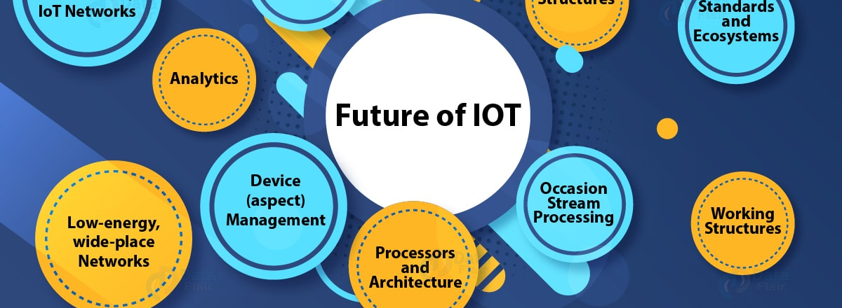
According to Fortune Business Insights, the global internet of things market was valued at US$190 billion in 2018 and is projected to reach US$1,102.6 billion by 2026, growing at a CAGR of 24.7 percent in the forecast period.
Finally, the IoT market will grow because existing IT devices will need to be linked to the IoT. Growth in traditional connected IT devices is admittedly moderate—about 2 percent per year. However, the installed base of more than five billion smart phones, two billion personal computers, and one billion tablets indicate a massive market for device integration.

Slide 20
References
www.google.com
https://en.wikipedia.org/wiki/Internet_of_Things
Cisco whitepaper, "The Internet of Things" - How the Next Evolution of the Internet Is Changing Everything, by Dave Evans, April 2011.
GE cloud expo 2014, "Industrial Internet as a Service", by Shyam Varan Nath, Principal Architect.
Dr. Mazlan Abbas, MIMOS Berhad, Wisma IEM, Petaling Jaya

